Slide 1

Session: Teaching the “N” in LLN
Presenter: Jim Spithill – ACER

Slide 2
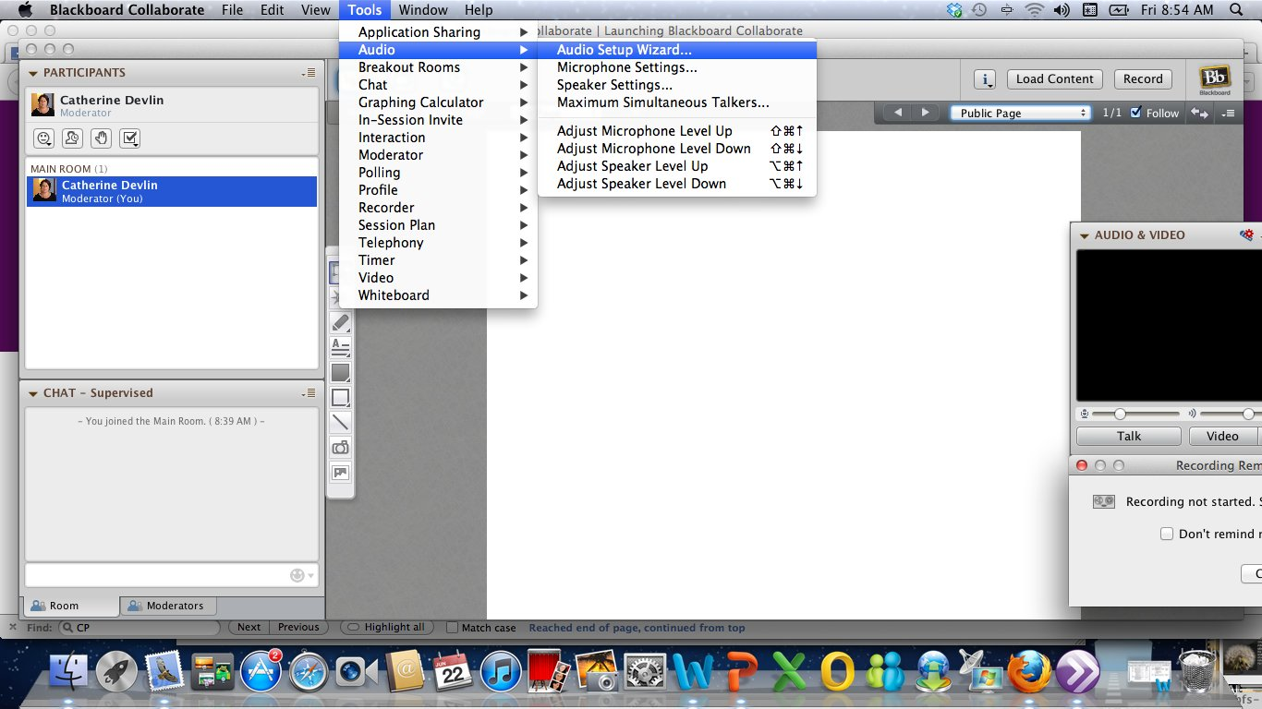

Slide 3
Teaching the ‘N’ in LLN:
A webinar for Adult Learning Australia
26 July 2013
Jim Spithill – Test developer, ACER
James.Spithill@acer.edu.au

Slide 4
Webinar outline
International perspectives on Numeracy: OECD and PIACC
Australian responses: ALLS and ACSF
Numeracy in the ACSF
Ordinary and mathematical English
Actively engaging the L’s in LLN to support the N: The Newman interview model

Slide 5
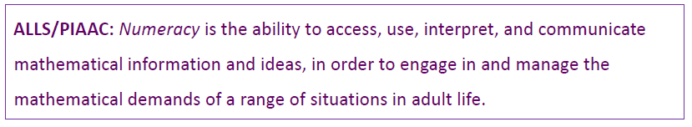
What is Numeracy?

Slide 6
International developments
The OECD has been promoting the importance of numeracy:
  Economic
  Social
  Personal
PIAAC results later this year will show where Australia stands in relation to 26 countries.

Slide 7
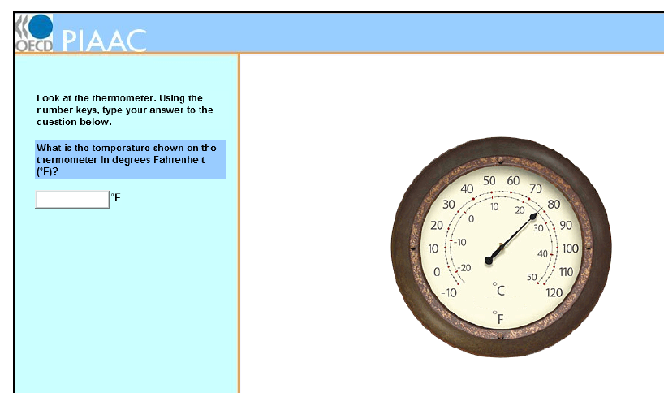
Numeracy items need L&L

Slide 8
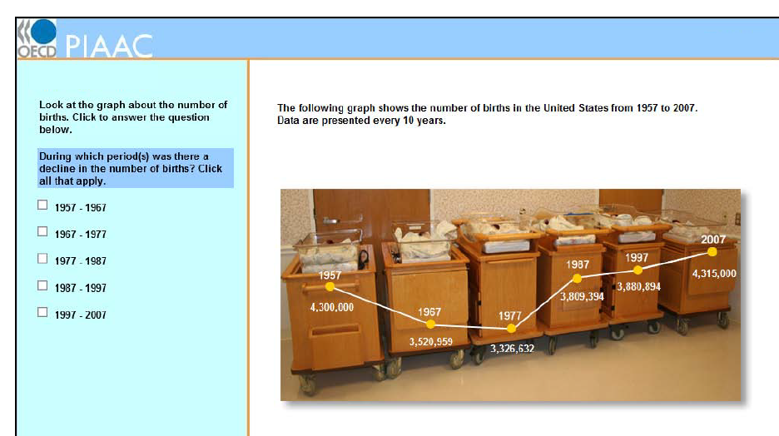
The data and the response need L&L

Slide 9
Australian situation
The ALLS survey of 2006 was a wake-up call: half the adult population are at Levels 1 or 2 in numeracy, whereas Level 3 is considered the minimum for successfully functioning in society.

Slide 10
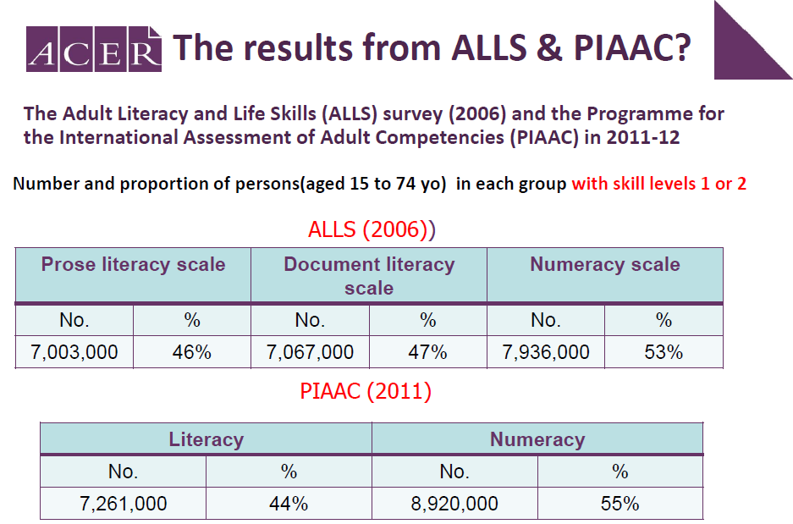

Slide 11
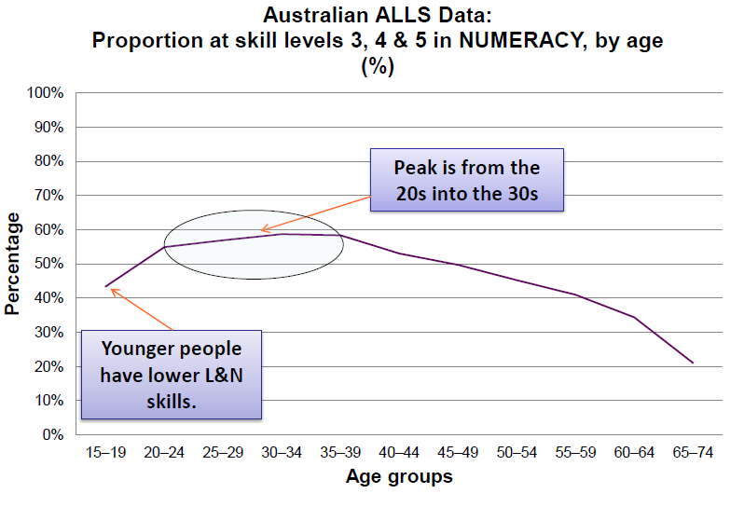

Slide 12

The Australian Core Skills Framework, ACSF, was developed to provide a common language and common understandings about numeracy and four other basic skills: learning, reading, writing and oral communication.

Slide 13
Numeracy in the ACSF
“Numeracy is about using mathematics to make sense of the world and applying mathematics in a context for a social purpose”.
Domains of Communication are:
personal and community
workplace and employment
education and training
ACSF p124

Slide 14
ACSF Numeracy Indicators
ACSF Indicators match with the three stages of problem solving:
.09 identifying mathematical information and meaning
.10 using and applying mathematical knowledge and problem solving processes
.11 communicating and representing mathematics
The first and third of these have a strong L&L requirement

Slide 15
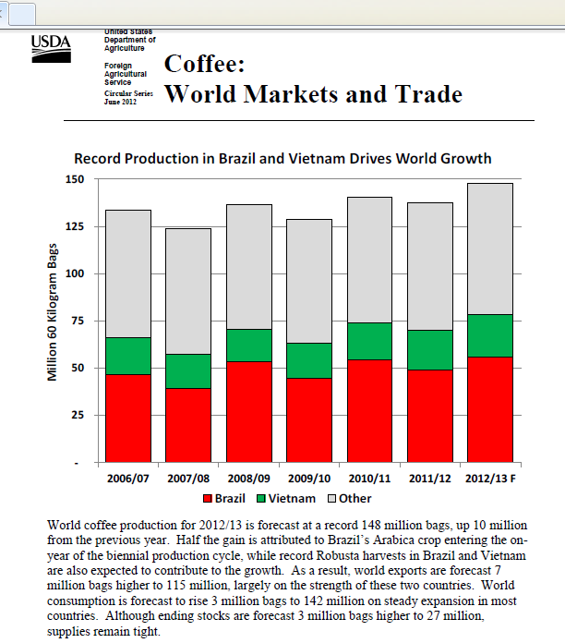
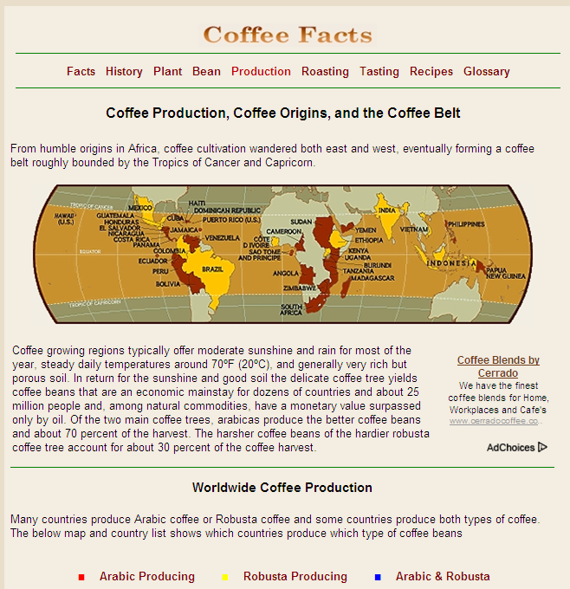

L&L give access to N:
including context
language and terminology
density of data and information
not a reading assessment
http://www.youtube.com/watch?v=8EqgosP1rWQ

Slide 16
Where is our coffee coming from?
The top five coffee producing countries in 2011/2012 were Brazil, Vietnam, Indonesia, Colombia and Ethiopia. The table shows their total coffee bean production figures.
And did you know that coffee beans are packed and measured in thousands of 60-kilogram (kg) bags?
2011/12 Coffee Production
Source: United States Department of Agriculture, June 2012
Country | 60-kg bags 1000s | Percentage (%) of world production
Brazil | 49,200 | 35.8%
Vietnam | 21,000 | 15.3%
Indonesia | 8,300 | 6.0%
Colombia | 7,500 | 5.5%
Ethiopia | 6,300 | 4.6%

Slide 17
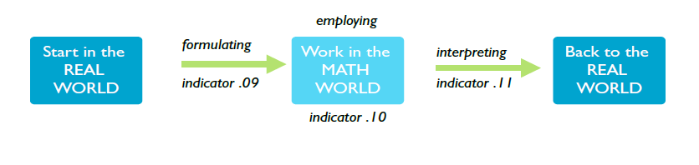
In summary, the numeracy task is to:

Slide 18
Ordinary and mathematical English
Merilyn Carter collected research findings for her M.Ed thesis at QUT.
  The words themselves: ‘eleven’ and ‘twelve’ are patterned differently from 1-10 and 13-19
  ‘milli’ prefix in million (10⁶) or millimetre (10⁻³)
  Homonyms in verbal communication: two/too/to, pi/pie, sign/sine
  Same word has different meanings: root, linear, variable, similar, square (even within Maths - geometry vs number), power, rational

Slide 19
Ordinary and mathematical English
  Synonyms: minus, less, subtract, take away, difference, etc for other operations
  Prepositions: ‘8 divided by 2’ vs ‘8 divided into 2’; ‘less’ vs ‘less than’
  Connecting words: ‘7 more than 5’ vs ‘7 is more than 5’
  Spatial words: ‘higher latitudes’, ‘go up to Sydney’, ‘driving north into a north wind’ .... (for 12 pages)
  Order reversal: we write $2 but say ‘two dollars’
  http://eprints.qut.edu.au/46648/1/Merilyn_Carter_Thesis.pdf

Slide 20
  Newman’s Error Analysis
Arose from research into language issues in Maths in the 1970’s
As much as 50% of errors in numeracy items are the result of language and literacy issues
Influenced various teaching programs in Australia such as ‘Counting On’ in NSW
Provides a structured model for numeracy development

Slide 21
Basic structure
When answering a worded problem students have to successfully negotiate the following 5 stages:
  read the actual words
  make sense of the words
  transform or “mathematize” their understanding of the situation into a mathematical form
  employ mathematical skills
  re-encode the result as a solution to the original problem

Slide 22
Basic structure: 5 stages
Reading/Decoding
    Read the problem, decode symbols indicator .09
Comprehending
    Make sense of what they have read indicator .09
Transforming
    Work out what maths needs to be done indicator .10
Processing
    Do the maths indicator .10
Encoding
    Record their final result appropriately indicator .11

Slide 23
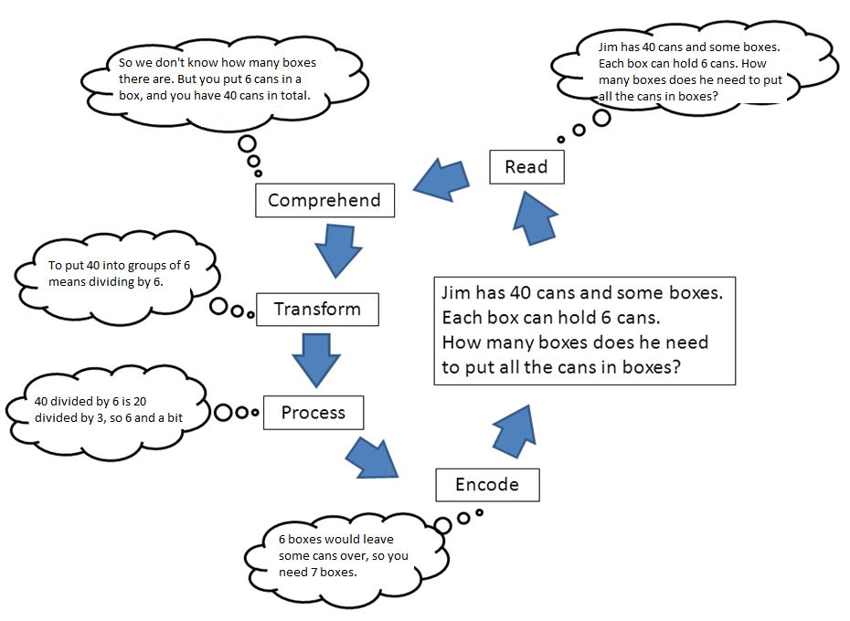

Slide 24
Tutor’s interview technique
Please read the question to me. If you don’t know a word, leave it out.
Tell me what the question is asking you to do.
Tell me how you are going to find the answer.
Show me what to do to get the answer. “Talk aloud” as you do it, so that I can understand how you are thinking.
Now, write down your answer to the question. (Newman, 1983)

Slide 25
In practice: Catherine and Jim demonstration
Climbing Mount Fuji
The Gotemba walking trail up Mount Fuji is about 9 kilometres (km) long. Walkers need to return from the 18 km walk by 8 pm.
Toshi estimates that he can walk up the mountain at
1.5 kilometres per hour on average, and down at twice that speed. These speeds take into account meal breaks and rest times.
Using Toshi’s estimated speeds, what is the latest time he can begin his walk so that he can return by 8 pm?

Slide 26
Reading and decoding issues
What are likely indications of decoding issues?
  Responses that show little or no engagement with the task
  Responses that are consistent with an obvious misreading
  Responses consistent with unfamiliarity with technical terms

Slide 27
Comprehension issues
What are likely indications of comprehension issues?
  Responses showing only a superficial engagement with the task
  Responses consistent with a different (but related) question from the one being asked
  What strategies can be adopted?
  Ask yourself “what do I have to find out or show?”
  Draw a diagram
  Restate the problem in your own words

Slide 28
Transformation issues
What are likely indications of transformation issues?
  Responses consistent with a different (but related) question from the one being asked
  Responses consistent with the right numbers being used but with the wrong operations (or in the wrong order)
  What strategies can be adopted?
  Guess and check
  Make a list or table
  Look for a pattern
  Make the numbers simpler
  Experiment or act it out

Slide 29
Process and Skill issues
What are likely indications of process issues?
  Arithmetic errors
  Procedural errors
  Incomplete solutions
What strategies can be adopted?
  Be patient: most problems are not solved quickly, nor on the first attempt
  Be persistent: do not allow yourself to become discouraged
  If one approach isn’t working try a different one

Slide 30
Encoding issues
What are likely indications of encoding issues?
  Incomplete solutions
  Responses that require some mathematical skill but which don’t answer the question asked
  Final checklist for the learner
  Does the answer make sense?
  Have I answered the question fully?
  Could I have done this problem by a different or easier method?
  What do I need to remember about these types of problems so that I get them right next time?

