Slide 1
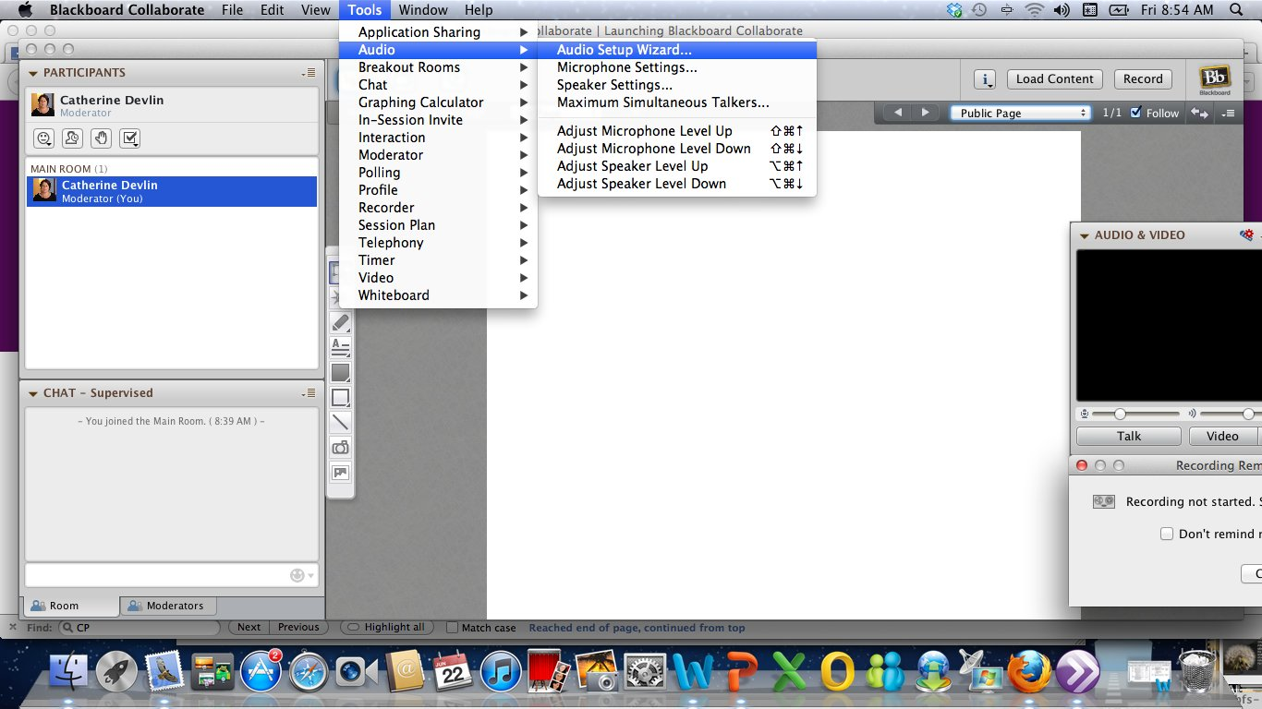
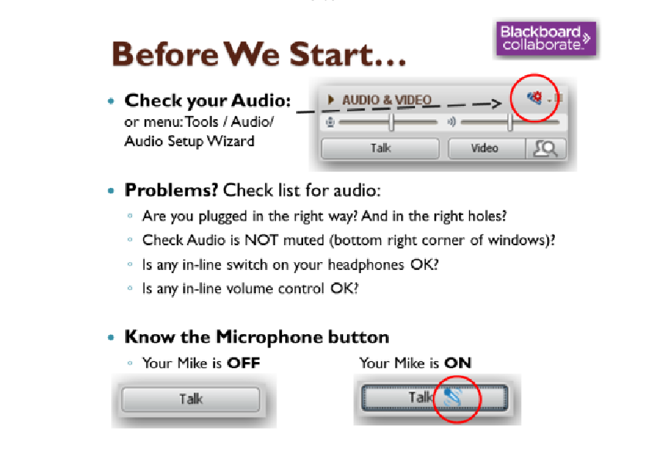
CLICK ONCE TO TALK. CLICK AGAIN TO TURN OFF

Slide 2

Developing new and innovative non-formal programs
Sue Ross
Chief Executive Officer
WEA of SA Inc
Notes:
Sue was appointed to the position of Chief Executive Officer of the Workers’ Educational Association of South Australia. The WEA is the largest provider of adult education in South Australia offering over 1800 courses with in excess of 25,000 enrolments per year.
With over 25 years experience in the adult community education sector she has been involved in many exciting and innovative programs which have included: capacity building of Community and Neighbourhood Houses in SA, Community based Language, Literacy and Numeracy, Community Engagement for People with a Disability, Parents Returning to Work, Youth at Risk, Mature Aged and long term unemployed.
Prior to commencing with the WEA Sue was the former Manager of the Adult Community Education and Community Partnerships Unit (Department of Further Education Employment Science and Technology – DFEEST). She represented the department on several state and a national committees including the MCEETYA ACE Taskforce. Since 2007, Sue has worked with the Adult Community Education Reference Group of the states Training and Skills Commission in the development and implementation of the South Australian governments Community Learning Strategy.

Slide 3
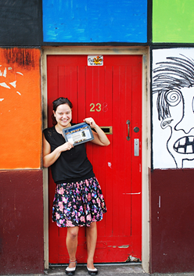
Developing new and innovative non-formal programs
What is innovation – How to innovate right now?
Examples
Marketing
Evaluation
Notes:
The biggest secret of innovation is that anyone can do it.
To innovate is to introduce something new.
The common trap about newness is the assumption that new means something that the universe has never seen before. Many great innovators, have borrowed and reused ideas from the past to make whatever it is they are famous for:
The Wright brothers, spent hours watching brides
Thomas Edison di not create the concept of powered light: all those who created the concept of light with wood, wax, oil and other fuels not to mention John Swan who patented the electric light before Edison
Google – search tool is called a search engine, in reference to concepts of physical mechanics, not digital bits.
As long as your idea, or your use of an existing idea, is new to the person you are creating it for, or applies an existing concept in a new way, you quality as an innovator from their point of view, and that’s all that matters.

Slide 4
Example - Italian
Italian - Year Long Language courses (Year 1,2,3)
Issues:
  high demand
  not all classes full
  high drop out rate
  feedback too much content, too high level

Slide 5
Italian language
Continue to offer Year long and market to existing students to re-enrol or continue on – offering the same tutor continuing.
Six monthly commencement (Jan – July)
Introductory courses:
  A little bit of language – Living French or Italian
    Short , affordable and fun. ($44) 1 day x 4 hours
    Discussion and word association in the classroom – then moved to a restaurant/café to put into practice.
  Languages for Fun and Travel
    Learn for fun or planning to travel
    10 weeks x 2 hours per week ($140)
Notes:
Continue to offer Year long and market to existing students to re-enrol or continue on – offering the same tutor continuing.
Six monthly commencement (Jan – July) Yearly long course are taken up by 70% of re-enrolments, 30% new. (25% of students undertake the first year for a second time to become more familiar with language. (Classes 1.5 hours per week per term – 32 weeks Fees: $227
Introductory courses:
A little bit of language – Living French or Italian
Short , affordable and fun. ($44) 1 day x 4 hours
Discussion and word association in the classroom – then moved to a restaurant/café to put into practice.
Languages for Fun and Travel (Learn for fun or planning to travel) 10 weeks x 2 hours per week ($140)

Slide 6
How to innovate right now
Ask Questions
  Who does it this, and how do they do it (or how can I do it) differently?
  Why is it done this way?
  What alternatives can be considered?
  What idea does the new idea replace?
  What are the biggest complaints with how do are doing?
  What changes might make it better?
  How is this done in other places, situations, cultures, venues?
  What different assumptions did they make or constraints did they have?
  How can I apply any of the above to what I do or want to do?
The common trap about newness is the assumption that new means something the universe has never seen before.
Notes:
Ask Questions:
Who does it this, and how do they do it (or how can I do it) differently? (If you only know one way to do something, you’re making a big assumption. You’re netting that of the infinite ways there are to do it, the single one you know is best.
Why is it done this way?
What alternatives can be considered?
What idea does the new idea replace?
What are the biggest complaints with how do are doing?
What changes might make it better?
How is this done in other places, situations, cultures, venues?
What different assumptions did they make or constraints did they have?
How can I apply any of the above to what I do or want to do?
Brainstorming with groups of people, helps with this process. Show the concept of existing students, tutors/educators, family and friends for feedback.
There is no substitute for firsthand experience when creating. The unique aspect of who you are, including qualities you may not like are an asset when it comes to creative thinking. This means that the individual experience, or make something with reflections from others, enables discovered
Lessons that individuals fail to notice.
Remember the knowledge we have today came from curious people who not only asked questions, but were independent thinkers who were willing to do things others around them refused to try.

Slide 7
How to innovate right now
Try things for yourself
  Experiment with a sample
    – Winter Taster Series (2 days and 1 night offering free sample classes – 1 -1.5 hour duration – limited number per person)
    Family open day – building on taster series
  Build on the experience
    Rebadge – rename - same content – different audience
Try, Learn and Try Again
  Don’t expect success the first time -- What’s important is how you respond to failure
    Why did it fail? What can I learn now? What will I do differently next time?
Notes:
Try things for yourself
There is no substitute for firsthand experience when creating. The unique aspect of who you are, including qualities you may not like are an asset when it comes to creative thinking. This means that the individual experience, or make something with reflections from others, enables discovered
Lessons that individuals fail to notice.
Remember the knowledge we have today came from curious people who not only asked questions, but were independent thinkers who were willing to do things others around them refused to try.
Brainstorming with groups of people, helps with this process. Show the concept of existing students, tutors/educators, family and friends for feedback.
Try, Learn and Try Again
Don’t expect success the first time around. The bigger the innovation the greater the risk and work there is: ie making innovative cookies is one thing, but changing the way people think or work is bigger.

Slide 8
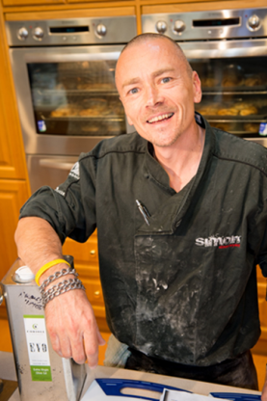
Marketing
Develop a marketing strategic plan – align with Business or Strategic Plan. (short 90 days and long term)
Continuously review this against your business Mission, Vision, Goals and Strategic Objectives.
  Seat of pants planning vs strategic planning
Target Audience and Segments
  Calls to action – what do you trying to get you audience to do? Be specific
Tactics and Resources
  The nitty – gritty how, who, what, how much.
Notes:
Marketing Template
Goals – What you need to accomplish
What are your organisations main 1-3 goals and marketing goals (how can marketing contribute to achieving organisational goals
Benchmarks – what are 3 – 5 concrete, specific and measurable (when poss) steps to complete en rout to achievement.
Situational Analysis – the conditions inside and outside your organisation
What is the environment in which you are working – whose next door, around the corner, what’s new and on the market?
Target audiences and Segments
Who are the 1-3 top target groups you need to engage. How do they break out into segments (with shared perspectives, habits and wants) so you know how to connect with them. ie Baby Boomers, Gen Y.
Call to Action – What you want you target audience to do? Be Specific – enrol now, ring now, sign up.
Frame the message – what’s in it for them?
Barriers – what challenges do you face in motivating or engaging? What’s going to be difficult?
Strategies – how can you best motivate your target audiences to act?
Tactics – how to connect your org with target audiences via these strategies – nitty gritty
Resources (staff – time, funding, social capital – board members, volunteers, hours per week, training (employ the right people with the right skills)
Budget – How much be clear and stick to the plan/budget
Step-by-Step – Start with a 90 day plan, extend to six months,12 months – 3 years
How to roll out the program? What are the immediate steps to take once you have an approved plan?

Slide 9
Evaluate
Staff feedback (Managers, Administrators)
  Improvements for efficiencies, information to students etc
Student feedback (individual)
  Written and online – overall course, content, delivery, environment, experience
Tutor
  Content
  Students – comments, issues etc
Continuous improvement
  Feedback to tutor on improvements for delivery
  Rename, rebadge, rework – taking on board the feedback
Notes:
Staff – those that are Managers and Administrators – issues – improvement, efficiencies.
Student – overall program/course; content; delivery; environment.
Tutor – engagement; delivery; environment; students. (Feedback to tutor from overall evaluation for improvements)
Online anonymous on the overall course – per individual course or all if more than one delivered over the term/year
Continuously improvement for new delivery – rename; advertising content – delivery for reach target audience.

