Slide 1


Understanding your Bill
Alternative Technology Association

Slide 2

Some Technical Terms
kWh?
‘kilowatt hour’
- a unit of electricity
MJ?
‘mega-joule’
- a unit of gas
Tariff?
the amount/rate ($) you pay per kWh

Slide 3
Some Technical Terms
Fixed charge
‘service’ charge
‘service to property’ charge
‘daily’ charge
- cents / $ per day
Demand charge
the rate ($) you pay per kW

Slide 4
Some Technical Terms
Peak
time period when energy (kWh or MJ) is charged higher
Off-peak
time period when energy is charged lower
Shoulder
time period when energy charge is middling

Slide 5
Some Technical Terms
Supply period
number of days supply this bill
NMI
‘National Meter Identifier’
- unique bar code for every site in the NEM
Meter No.
Number associated with each individual meter or meter register/circuit

Slide 6
Some Technical Terms
Inclining block
where energy is charged at a higher rate the more you consume
e.g. first 1,000 kWh @ $0.23/kWh
e.g. next 1,000 kWh @ $0.25/kWh
Declining block
where energy is charged at a lower rate the more you consume (e.g. gas)

Slide 7
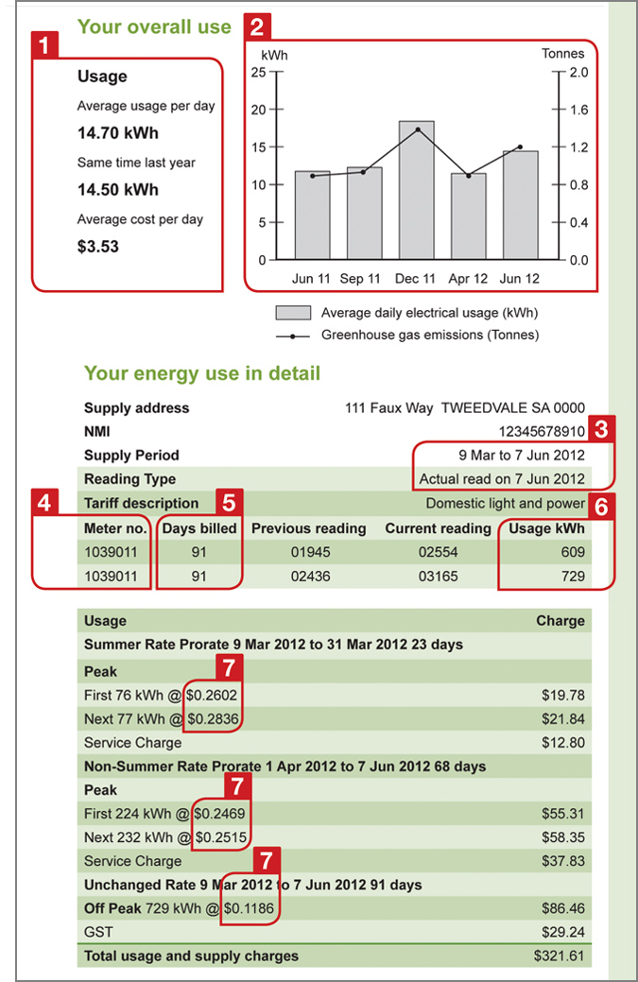
**

Slide 8
**

Slide 9
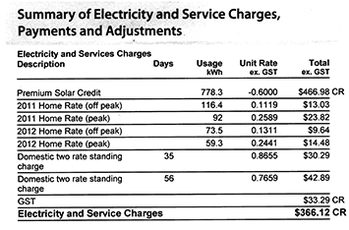
Feed-in Tariffs

Slide 10
The thing about bills is....
The good
great information on average, total consumption
easy to compare between seasons
The bad
can’t tell the daily/weekly profile of your consumption
can’t tell which appliances are using the most

Slide 11
Energy Efficient Lighting
Alternative Technology Association

Slide 12

Where do I Start?

Slide 13
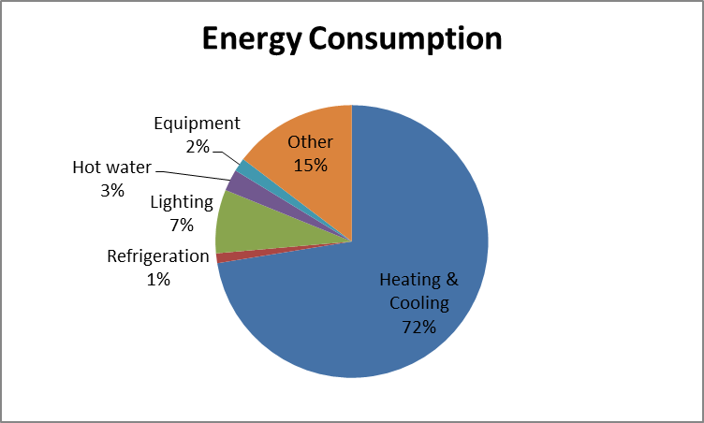
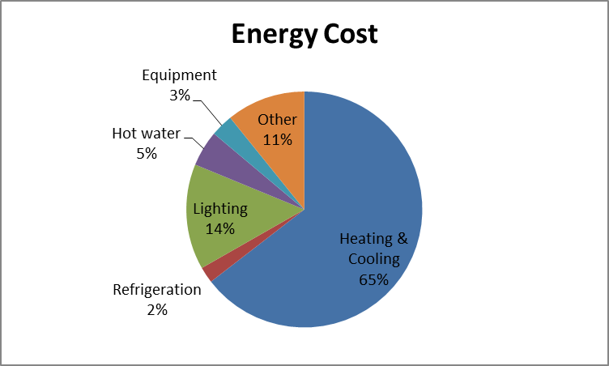
How significant is Lighting?
Approx. $800/year

Slide 14
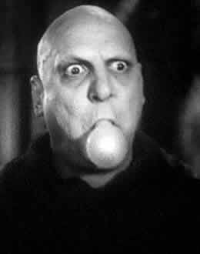
Is it worth replacing?
Even for small usage levels, lighting can be worth swapping out.
New, efficient lighting uses much less electricity and can pay for itself very quickly
(often <2 years)

Slide 15
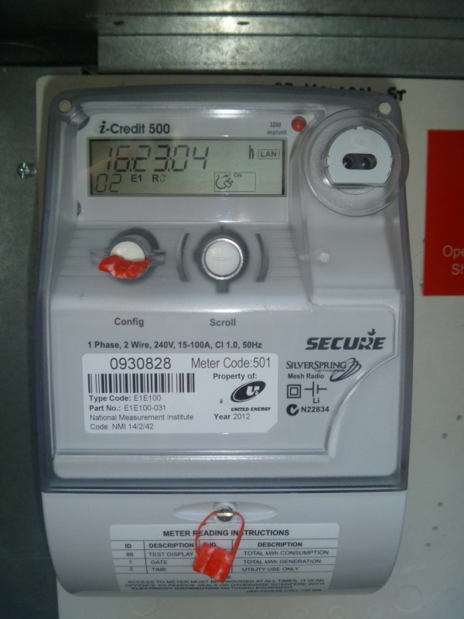
How can I find out my lighting load?
Notes:
“The result shows that the TNSPs in Queensland and New South Wales projected actual
peak demand to be, on average, around 1,200 MW and 740 MW higher than it has been
over this period, respectively. In Victoria, peak annual demand was on average 287 MW
higher than the actual demand.”
We expect annual variation of course, but if the forecasting were accurate in the longer term, these values would be close to zero.

Slide 16
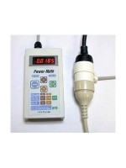
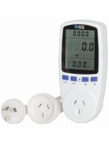
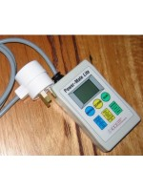
Energy Meters
How much electricity do my lights use?
Notes:
“The result shows that the TNSPs in Queensland and New South Wales projected actual
peak demand to be, on average, around 1,200 MW and 740 MW higher than it has been
over this period, respectively. In Victoria, peak annual demand was on average 287 MW
higher than the actual demand.”
We expect annual variation of course, but if the forecasting were accurate in the longer term, these values would be close to zero.

Slide 17
Lighting Audit
 |  | power | power | power |  |  | use details |  | Location use
Location | type | light | starter | total | number | use - day | use - wk | use - yr | use - hrs | use - hrs | use - yr | Cost
 |  | (W) | (W) | (W) | (each) | (hrs/day) | (day/wk) | (wk/yr) | (hrs/yr) | (hrs/yr) | (kWh/yr) | ($/yr)
Church auditorium | fluro tube | 20 | 10 | 30 | 4 |  |  |  | 208 | 208 | 25 | $ 7
Church auditorium | fluro tube | 40 | 10 | 50 | 23 |  |  |  | 208 | 208 | 239 | $ 70
Church auditorium | fluro globe | 48 | 0 | 48 | 8 |  |  |  | 208 | 208 | 80 | $ 23
Church auditorium | incandescent | 40 | 0 | 40 | 3 |  |  |  | 208 | 208 | 25 | $ 7
Offices | fluro tube | 40 | 10 | 50 | 4 |  |  |  | 104 | 104 | 21 | $ 6
Offices | incandescent | 60 | 0 | 60 | 2 |  |  |  | 104 | 104 | 12 | $ 4
Hall - main | fluro tube | 40 | 10 | 50 | 16 |  |  |  | 1404 | 1404 | 1123 | $ 328
Hall - main | incandescent | 150 | 0 | 150 | 4 | 2 | 1 | 10 | 1404 | 20 | 12 | $ 4
Hall - main | incandescent | 60 | 0 | 60 | 2 | 2 | 1 | 10 | 1404 | 20 | 2 | $ 1
Craft rooms | fluro tube | 40 | 10 | 50 | 2 |  |  |  | 24 | 24 | 2 | $ 1
Hall - main | fluro tube | 40 | 10 | 50 | 1 |  |  |  | 1404 | 1404 | 70 | $ 20
Kitchen | fluro tube | 40 | 10 | 50 | 4 |  |  |  | 234 | 234 | 47 | $ 14
Toilets | fluro globe | 25 | 0 | 25 | 3 |  |  |  | 2452 | 2452 | 184 | $ 54
Meeting Room | fluro tube | 40 | 10 | 50 | 6 |  |  |  | 600 | 600 | 180 | $ 53
External | fluro tube | 20 | 10 | 30 | 3 |  |  |  | 218 | 218 | 20 | $ 6
External | fluro tube | 20 | 10 | 30 | 2 | 5 | 7 | 52 | 218 | 1820 | 109 | $ 32
External | fluro tube | 20 | 10 | 30 | 6 |  |  |  | 218 | 218 | 39 | $ 11
Toilets | incandescent | 40 | 0 | 40 | 6 |  |  |  | 2452 | 2452 | 588 | $ 172
External | incandescent | 150 | 0 | 150 | 2 |  |  |  | 218 | 218 | 66 | $ 19
Hall - old | fluro tube | 40 | 10 | 50 | 19 |  |  |  | 216 | 216 | 205 | $ 60

Slide 18
What types are there?

Slide 19
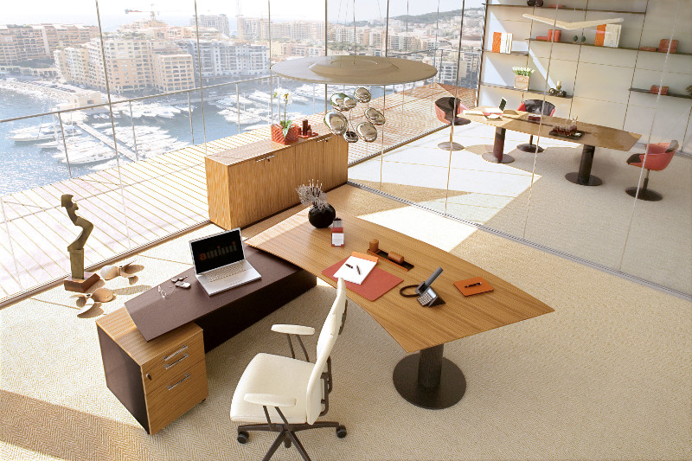
Natural Light

Slide 20
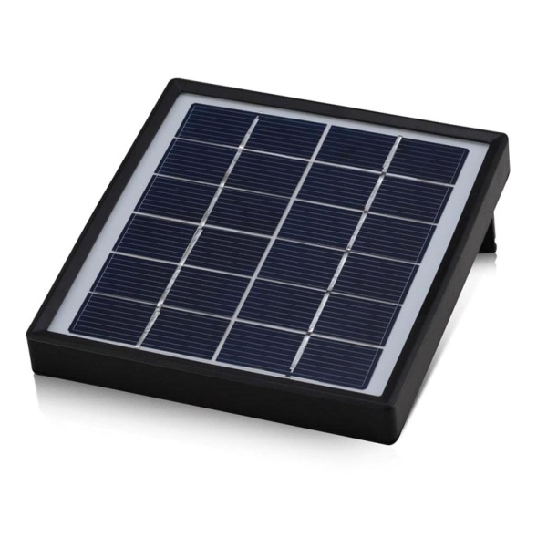
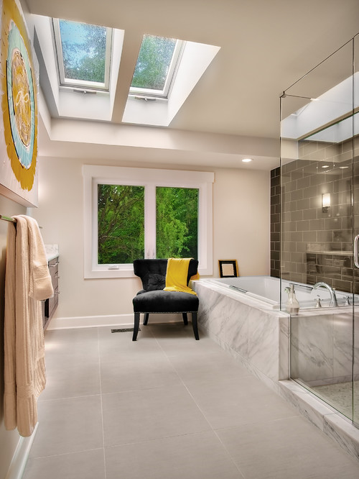
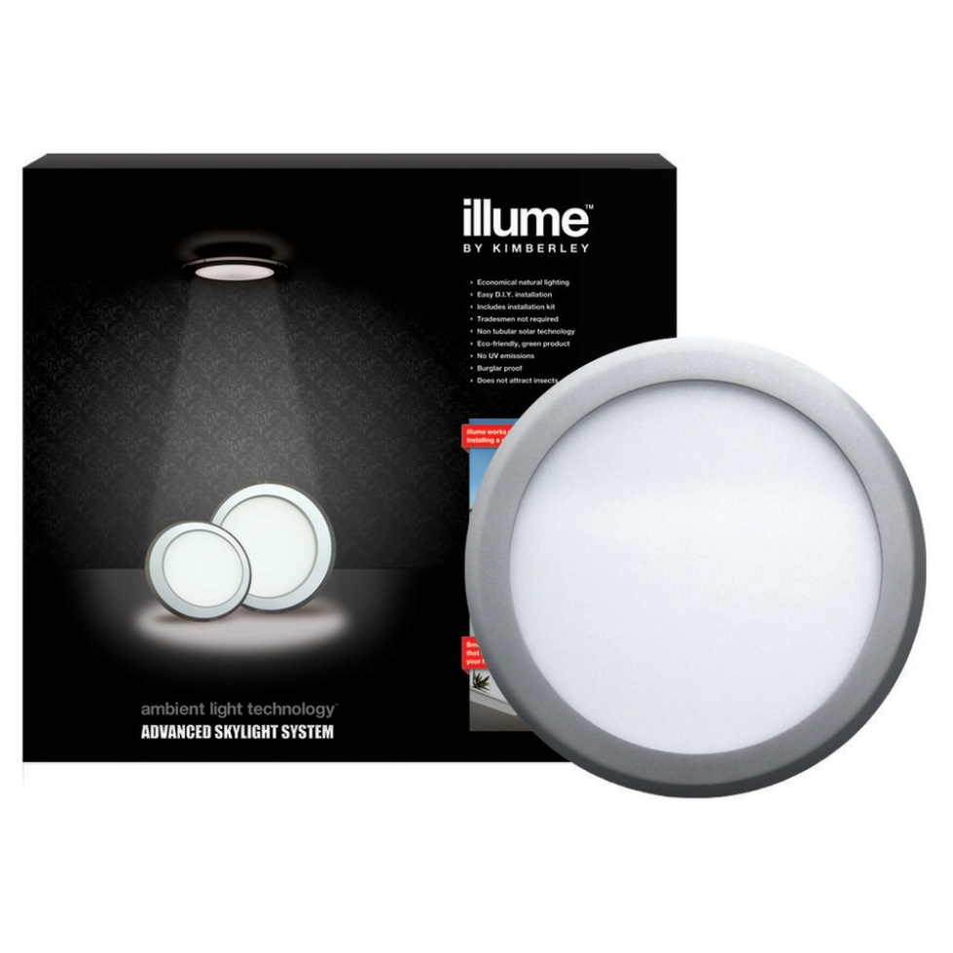
Natural Light?
Heat Loss…?
No Heat Loss…

Slide 21
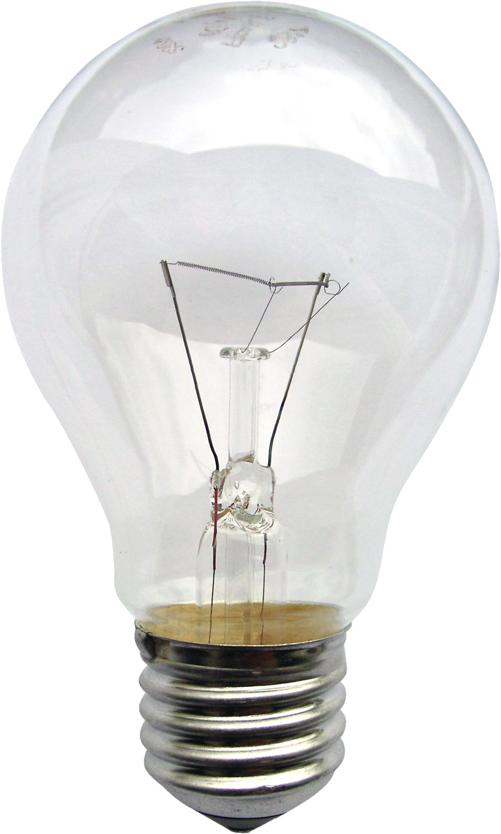
Incandescent
Great heaters!
  (approx. 5-10% electrical energy ends up as light)

Slide 22
Incandescent
Produces light by heating a wire filament with electrical current
Works on either AC or DC
Light output (Lumens): ~16 lumens/watt
(CFL: 60 lm/w)
Short lifetimes - around 1,000 hours
Gradually being phased out

Slide 23
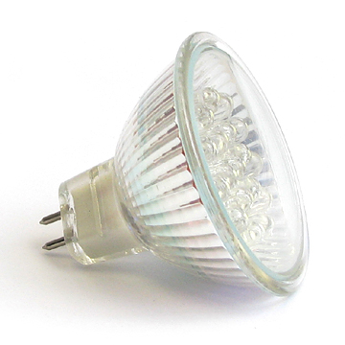
Halogen
Even better heaters!
  (no more than 5% electrical energy ends up as light)

Slide 24
Halogen
Incandescent with small amount of halogen
Gas & filament produces chemical reaction
- increasing light output & colour temp
Operates at high temps – but low quality casing - hence significant heat loss
Often low voltage – but not low energy!
- 12V needs additional transformer for 240V supply

Slide 25
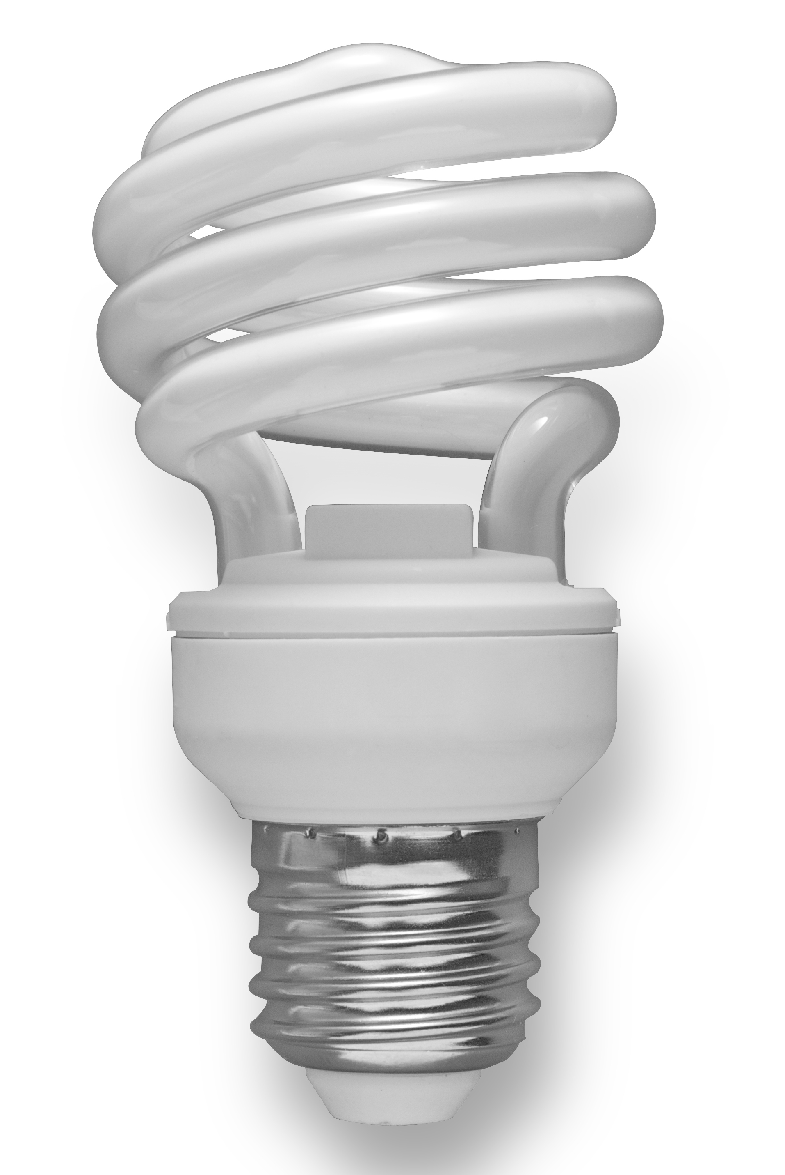
Compact Fluorescent (CFL)
The ‘Nokia’ of Lighting
  (use 60-80% less energy than incandescent)

Slide 26
Compact Fluorescent (CFL)
Familiar curved tube, compact ballast in lamp base
Mercury atoms radiate ultraviolet light – converted to visible light (and heat) as it strikes the bulb coating
All fluorescents contain mercury – complicating disposal
8,000 – 15,000 operating hours

Slide 27
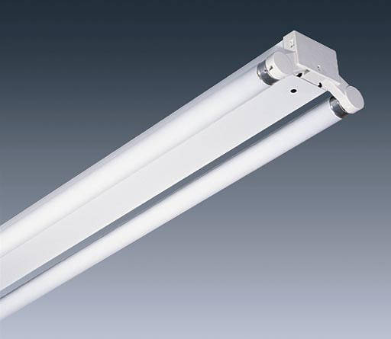
Fluorescent
More often associated with these!

Slide 28
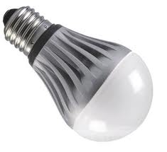
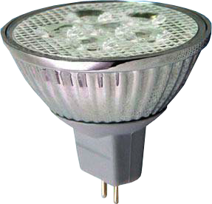
LED
The ‘iPhone 6’
  (use 90%+ less energy than halogen and 50% less than CFLs)

Slide 29
LED
Light Emitting Diode
Electronic chip & DC power to emit light
Include heat dissipation (sinks and cooling fins)
Lifespan of 20,000 – 100,000 hours
Efficient & effective: < 10watts & > 100 lumens/watt
No warm-up time (like CFLs)
Drop-in replacements for incandescents, halogen or CFLs
Do not emit light in all directions
Lower lumen output - multiple LEDs used to form lamp

Slide 30
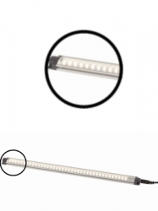
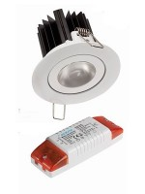
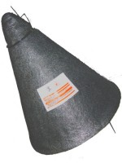
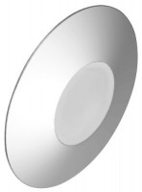
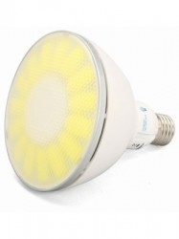
LEDs of all Shapes & Sizes!
Dimmable LED (with driver)
LED Strip
Light
Insulating Cover
LED Spot/
Outdoor Light
LED Disc

Slide 31
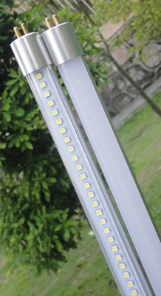
LED do Fluoro Tubes too!

Slide 32
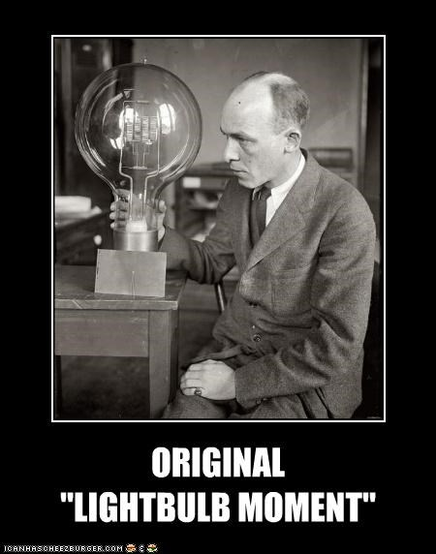
What should I look for in a lamp?

Slide 33
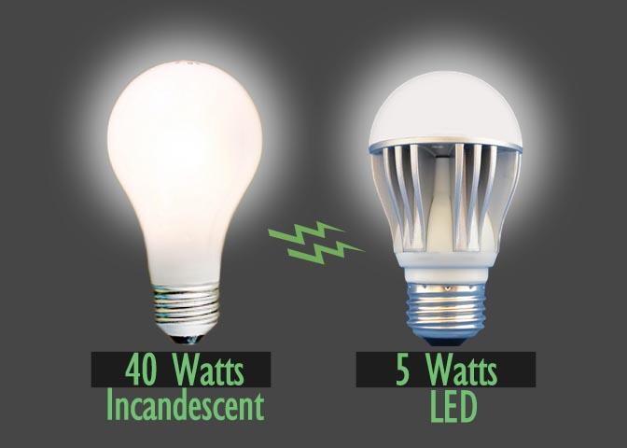
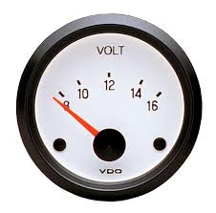
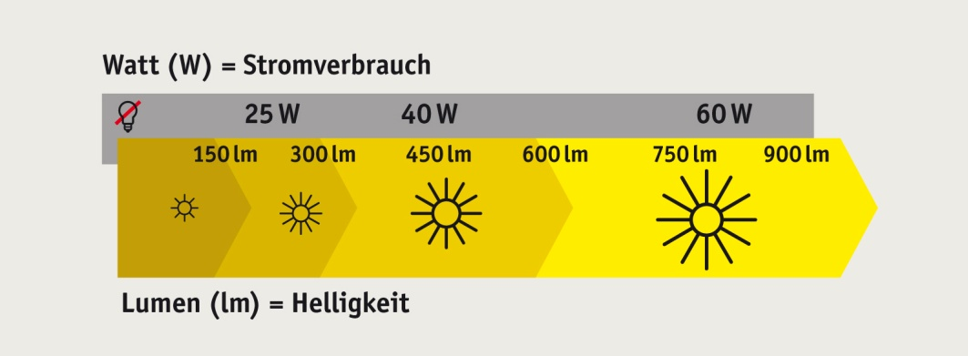
What should I look for in a lamp?
Wattage (say-watt?): measure of power
(single digits good, double digits bad.....)
Voltage: 12V or 240V?
(....down-lights - MR16 or GU10)
Lumens per Watt: measure of efficacy of lamp
Lumens: brightness
(strength of visible light)

Slide 34

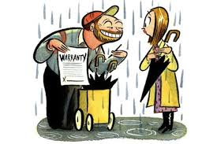
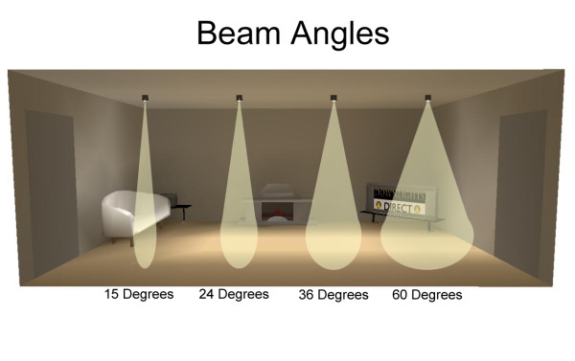
What should I look for in a lamp?
Expected lifetime (hours)
(....some unproven LED claims...)

Slide 35
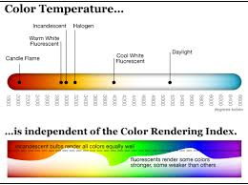
What should I look for in a lamp?
Colour Temperature: the colour of the visible light
Normally stated in Kelvin (K) – an absolute unit of temperature
Relevant to the reddish/orange via yellow and white to blue-ish/white spectrum
- 5,000K+ cool colours (blue-ish white)
- 2,700K - 3,000K warm colours (yellowish white through red)
Colour Rendering Index (CRI):
Ability of a lamp to reveal surrounding colours of various objects (compared with natural light)
High CRI desirable in colour-critical applications (e.g. photography, cinematography)

Slide 36

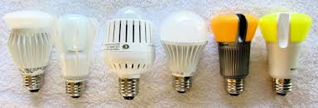
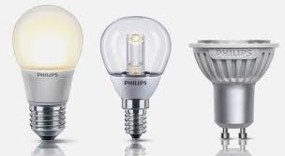
LEDs!

Slide 37

But LEDs Cost Heaps!

Slide 38
Case Study 1: Halogen to LED
Halogen Lamp:
Price $1.00
Power: 50 watts
Lifetime: 5,000 hours
Hours Use: 8 hours/weekday
Annual Cost¹: $26.00
LED Lamp:
Price $20.00
Power: 7 watts
Lifetime: 25,000 hours
Hours Use: 8 hours/weekday
Annual Cost¹: $3.64
A Greenhouse around the Corner – Webinar

Slide 39
Case Study 1: Halogen to LED
LED Lamp:
(at 7% discount rate)
Payback: <1 year
Years operation: 12
(Halogen: 2.4 years)
NPV: $128² (year 10)
A Greenhouse around the Corner – Webinar

Slide 40
Case Study 2: CFL to LED
CFL Lamp:
Price $4.00
Power: 15 watts
Lifetime: 15,000 hours
Hours Use: 8 hours/weekday
Annual Cost¹: $7.80
LED Lamp:
Price $15.00
Power: 5 watts
Lifetime: 25,000 hours
Hours Use: 8 hours/weekday
Annual Cost¹: $2.60
A Greenhouse around the Corner – Webinar

Slide 41
Case Study 2: CFL to LED
LED Lamp:
(at 7% discount rate)
Payback: 2.5 years
Years operation: 12
(CFL: 7.2 years)
NPV: $23.85 (year 10)

Slide 42
Case Study 3: Fluoro Tube to LED
Fluoro Tube:
Price $4.90 (2-pack)
Power: 36 watts
Lifetime: 20,000 hours
Hours Use: 8 hours/weekday
Annual Cost¹: $37.50
LED Tube:
Price $30.00 (each)
Power: 10 watts
Lifetime: 45,000 hours
Hours Use: 8 hours/weekday
Annual Cost¹: $5.20
A Greenhouse around the Corner – Webinar

Slide 43
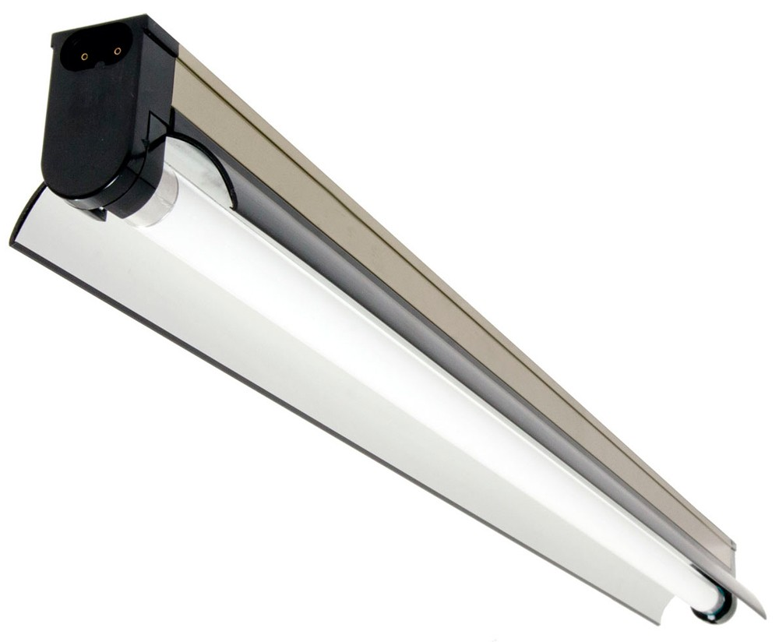
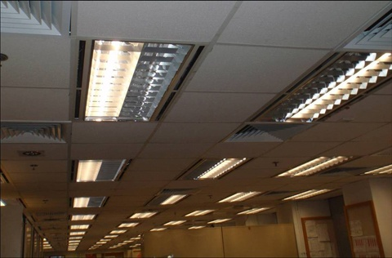
Case Study 3: Fluoro Tube to LED
“De-lamping”
replacing/using only 1 tube with a reflector strip

Slide 44
Case Study 3: Fluoro Tube to LED
De-lamp + 1x LED Tube:
(at 7% discount rate)
Payback: 1.5 years
Years operation: 21.6
(Fluoro: 9.6 years)
NPV: $165 (year 10)

Slide 45

www.greenhouse.net.au
Fact Sheets & Video Clips:

Slide 46

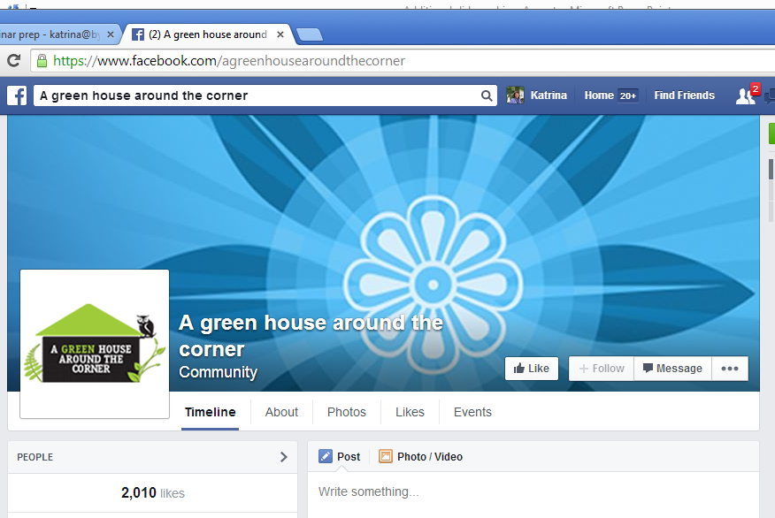
A Green House around the Corner

